Slide 2
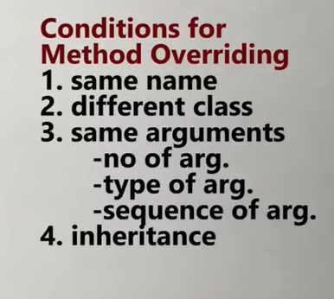

Slide 3
Polymorphism
Greek word, and the meaning is- many or multiple forms.
Same operations behave differently in different contexts.
The operation “area “ is same but it will take different forms depending upon type & number of arguments passed to area.

Slide 4
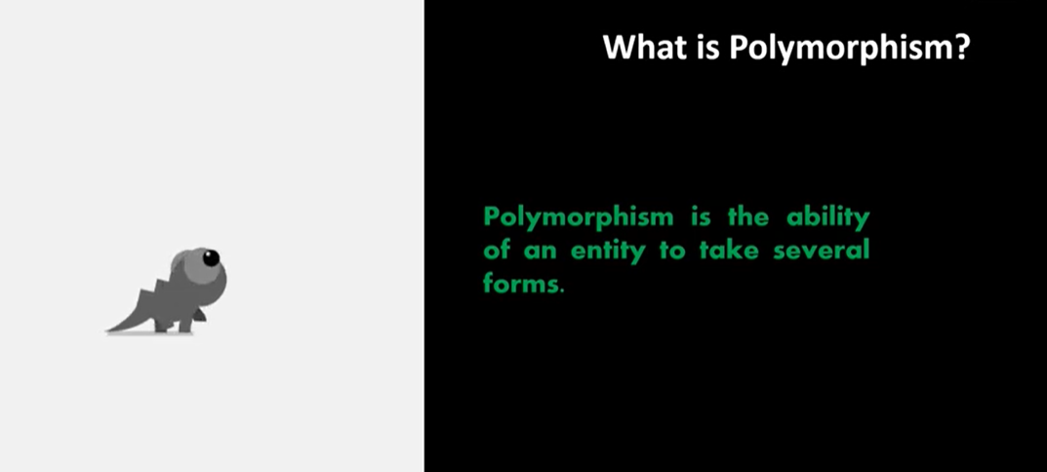

Slide 5
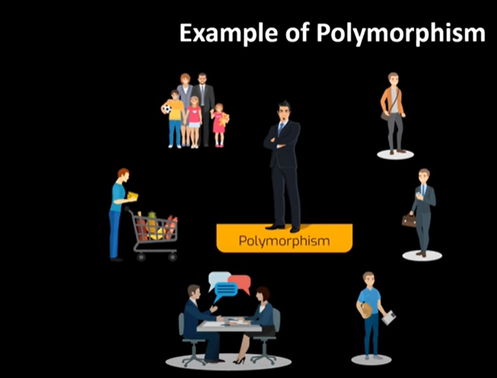

Slide 6
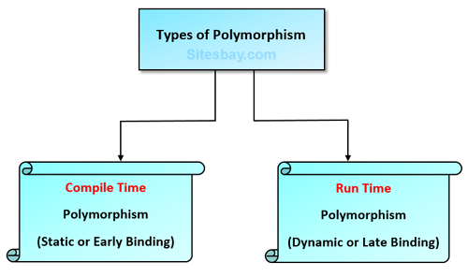

Slide 7
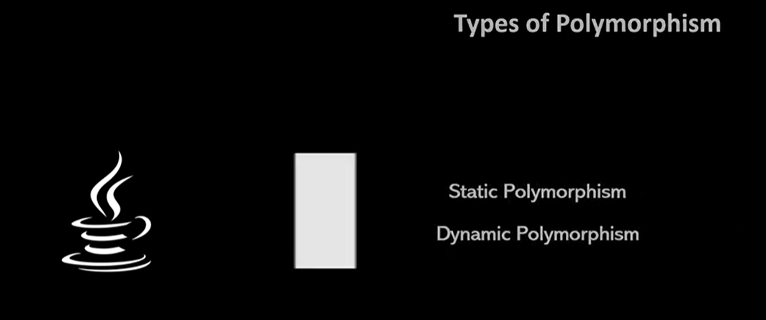

Slide 8
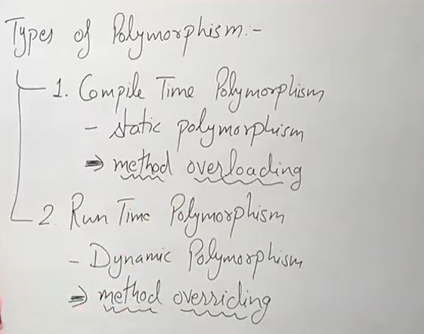

Slide 9
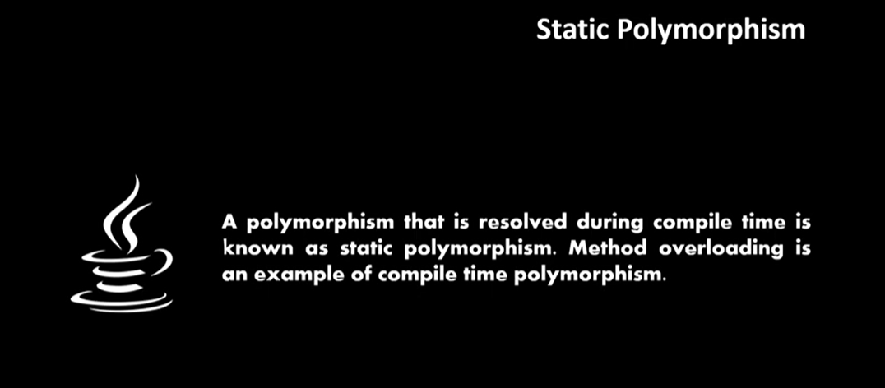

Slide 10
Polymorphism
int add (int a, int b);
int add (int a, int b, int c);
float add (int x, float y);
float add (float p, int q);
float add (float x, float y);

Slide 11
void max(int x, int y)
{
if(x>y)
cout<<x<<"is greater";
else
cout<<y<<"is greater";
}
void max(float x, float y)
{
if(x>y)
cout<<x<<"is greater";
else
cout<<y<<"is greater";
}
void max(char x, char y)
{
if(x>y)
cout<<x<<"is greater";
else
cout<<y<<"is greater";
}
int main()
{
max(‘A', ‘Z');
max(3, 7);
max(44.66, 22.13);
}

Slide 12
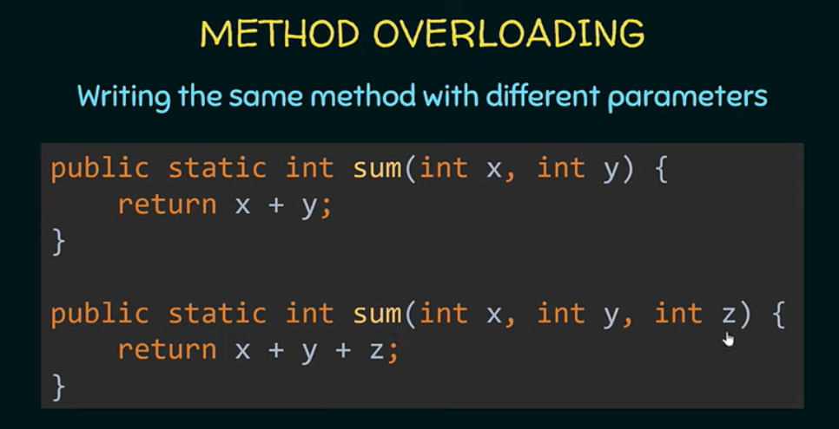

Slide 13
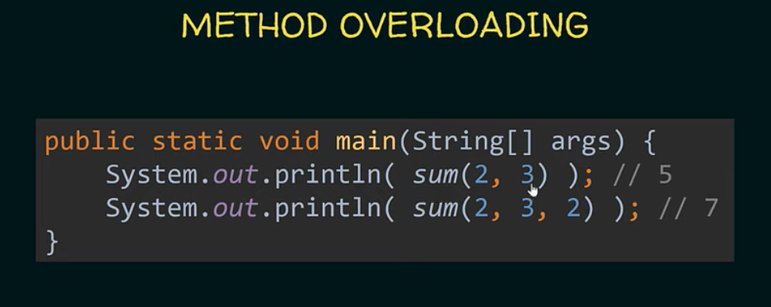

Slide 15
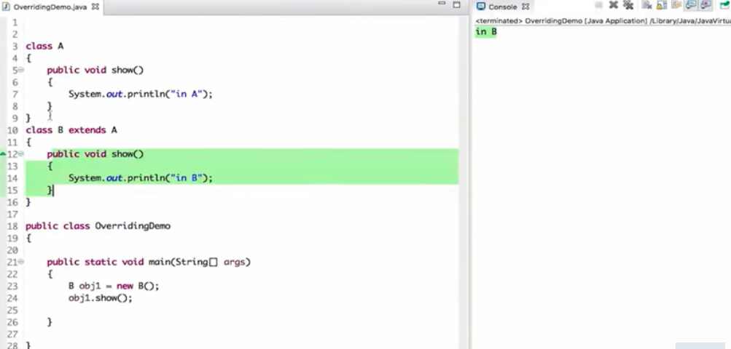

Slide 16
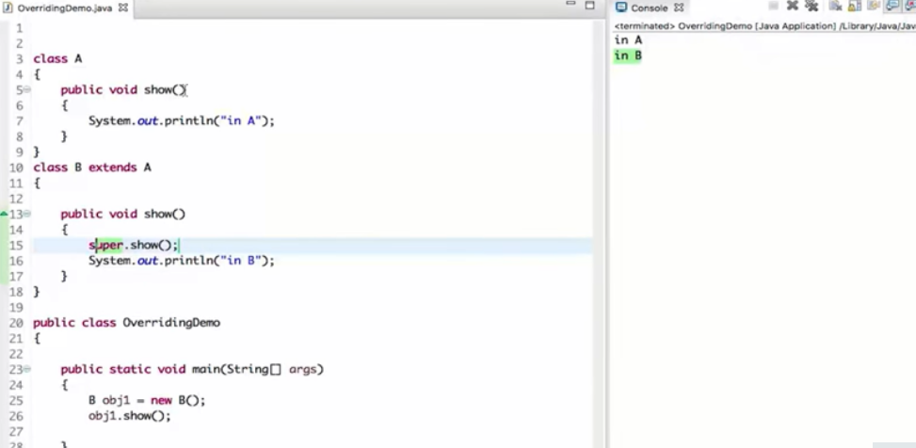

Slide 17
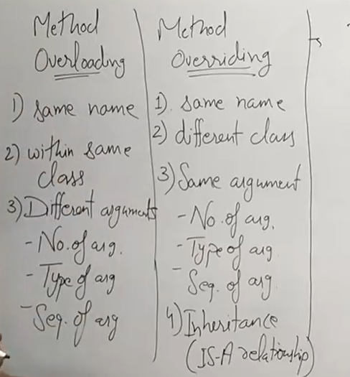

Slide 18
Overloading vs. Overriding
Don't confuse the concepts of overloading and overriding
Overloading deals with multiple methods with the same name in the same class, but with different signatures
Overriding deals with two methods, one in a parent class and one in a child class, that have the same signature
Overloading lets you define a similar operation in different ways for different data
Overriding lets you define a similar operation in different ways for different object types

Slide 19
class test{
void show()
{
System.out.println("1");
}
void show()
{
System.out.println("2");
}
}
public class Main{
public static void main(String[] args) {
test ob=new test();
ob.show(); //syntax error
}
}

Slide 20
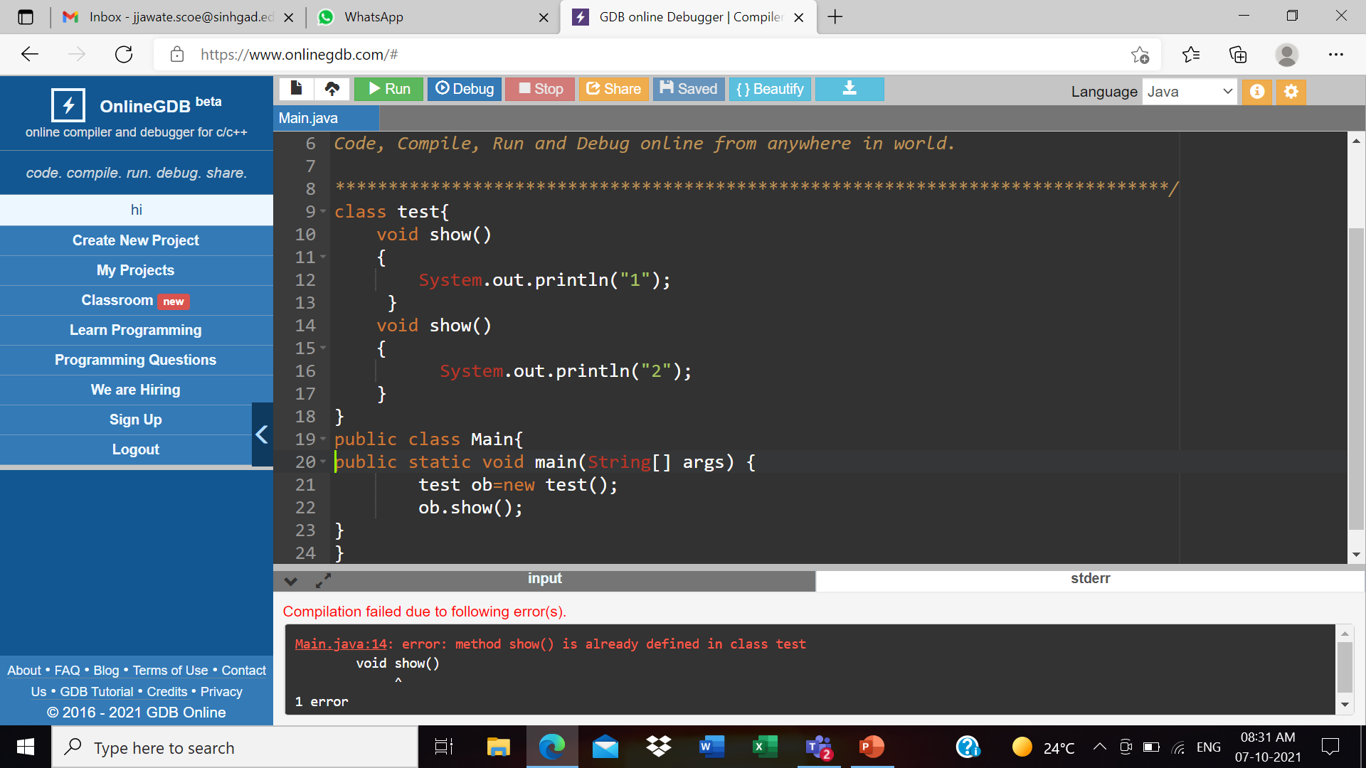

Slide 21
class test
{
void show(int a)
{
System.out.println("1");
}
void show()
{
System.out.println("2");
}
}
public class Main
{
public static void main(String[] args) {
test ob=new test();
ob.show(); //output: 2
}
}

Slide 22
class test
{
void show(int a)
{
System.out.println("1");
}
void show()
{
System.out.println("2");
}
}
public class Main
{
public static void main(String[] args) {
test ob=new test();
ob.show(100); //Output :1
}
}

Slide 23
class test
{
void show(int a,int b)
{
System.out.println("1");
}
void show(int a)
{
System.out.println("2");
}
}
public class Main
{
public static void main(String[] args) {
test ob=new test();
ob.show(10,20);
}
}

Slide 24
class test
{
void show(int a,String b)
{
System.out.println("1");
}
void show(String a,int b)
{
System.out.println("2");
}
}
public class Main
{
public static void main(String[] args) {
test ob=new test();
ob.show("scoe“,500); //output:2
}
}

Slide 25
class test
{
void show(int a,String b)
{
System.out.println("1");
}
void show(String a,int b)
{
System.out.println("2");
}
}
public class Main
{
public static void main(String[] args) {
test ob=new test();
ob.show(100,"scoe"); //output:1
}
}

Slide 26
class test
{
void show(int a)
{
System.out.println("1");
}
void show(String a)
{
System.out.println("2");
}
}
public class Main
{
public static void main(String[] args) {
test ob=new test();
ob.show("scoe"); //output:2
}
}

Slide 27
class test
{
void show(int a)
{
System.out.println("1");
}
void show(String a)
{
System.out.println("2");
}
}
public class Main
{
public static void main(String[] args) {
test ob=new test();
ob.show(100); //output:1
}
}

Slide 28
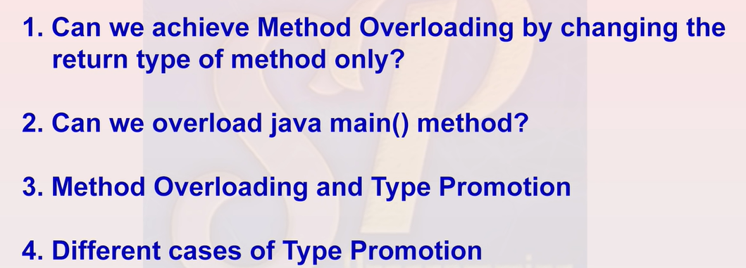

Slide 29
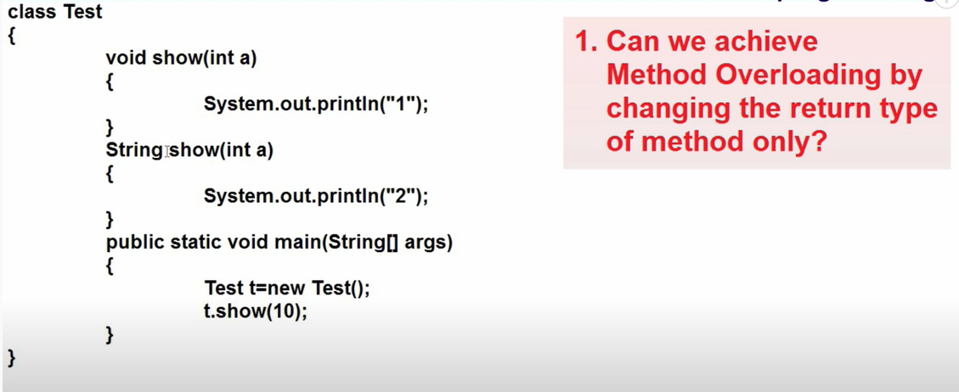

Slide 30
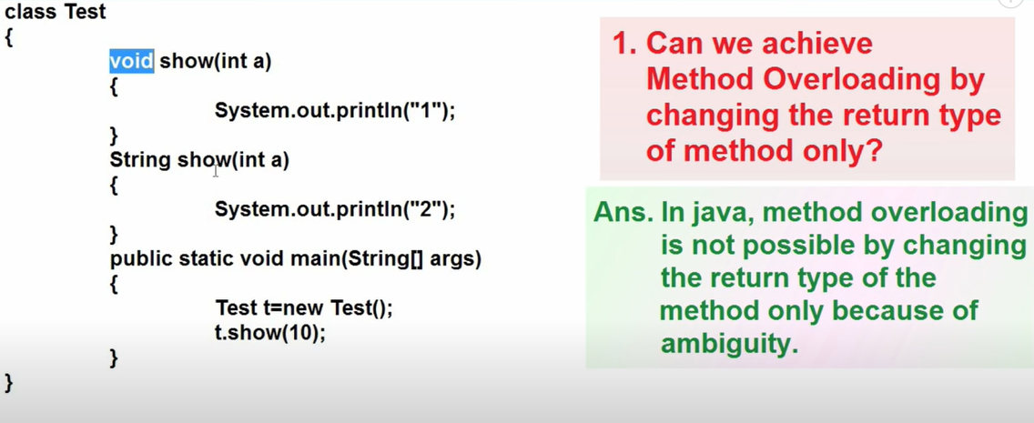

Slide 31
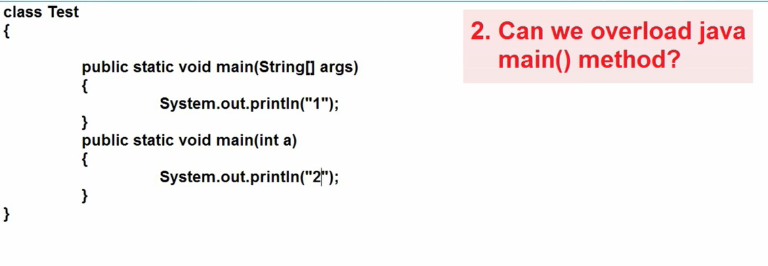

Slide 32
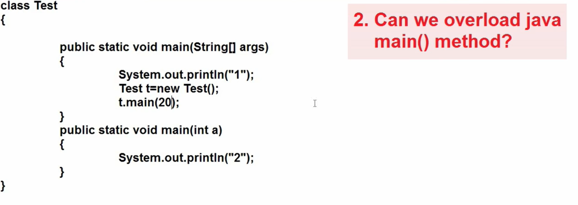

Slide 33
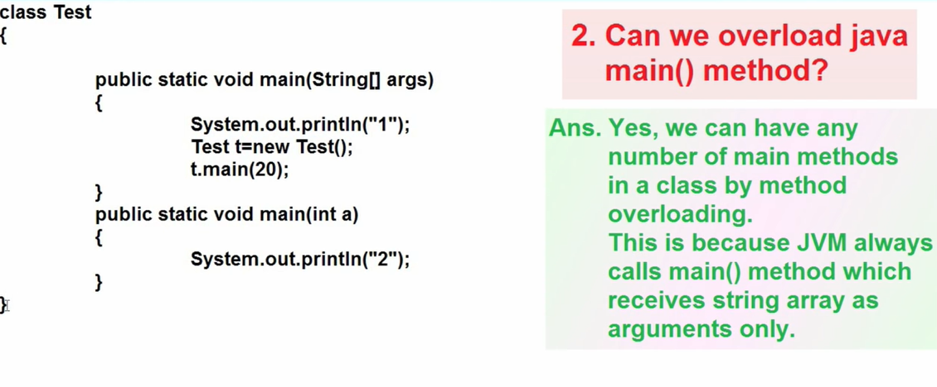

Slide 34
public class Main
{
public static void main(String[] args)
{
System.out.println("1");
Main ob=new Main();
ob.main(10);
}
public static void main(int a)
{
System.out.println("2");
}
}

Slide 35
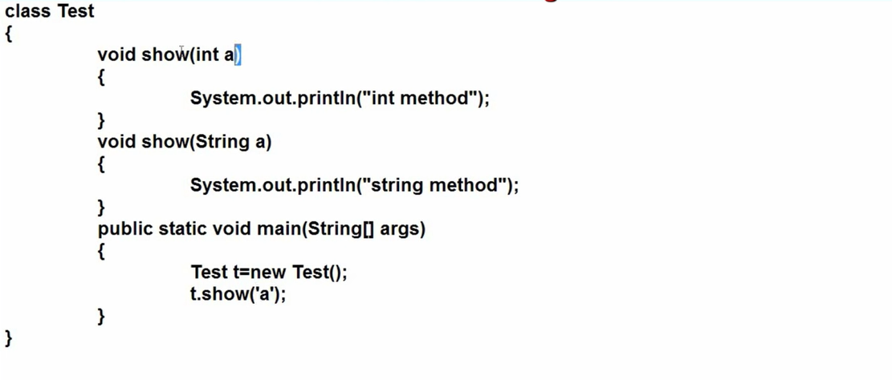

Slide 36
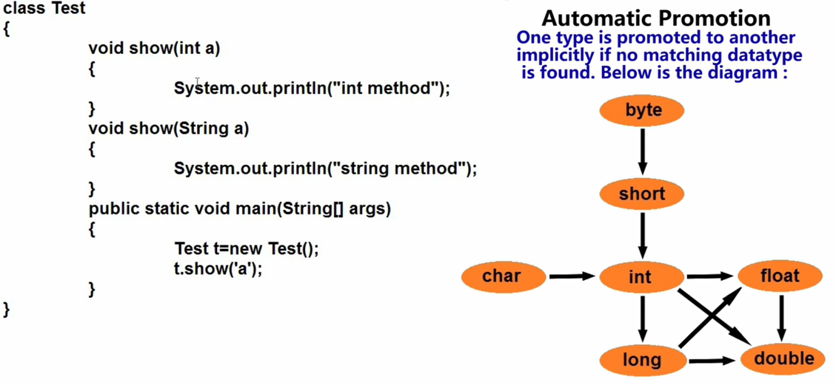

Slide 37
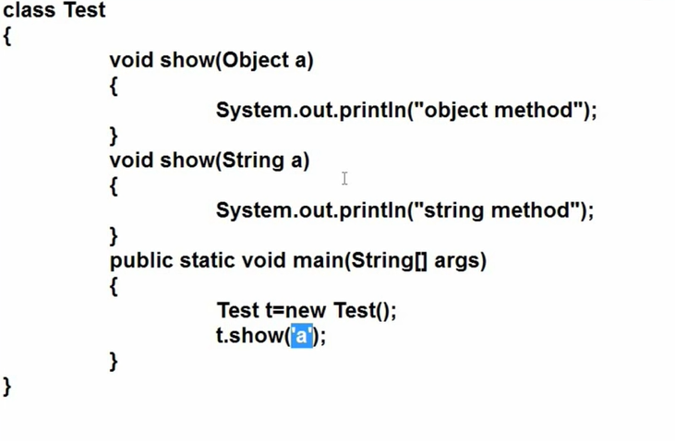

Slide 38
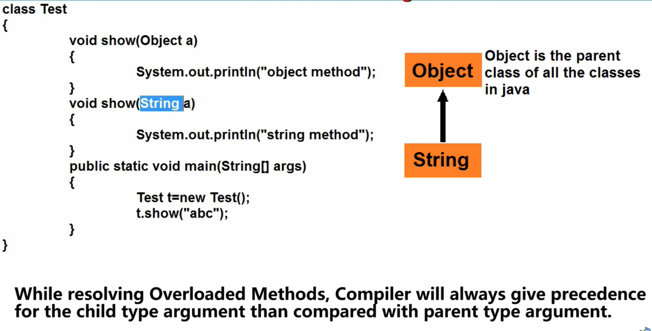

Slide 39
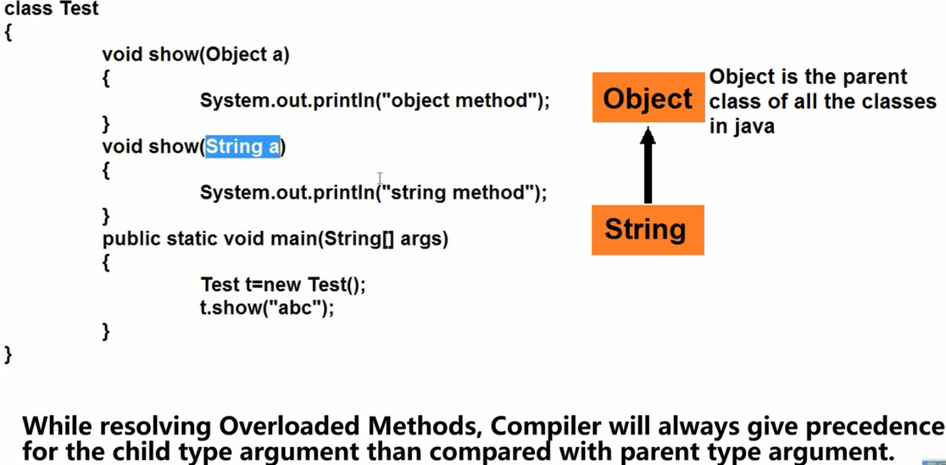

Slide 40
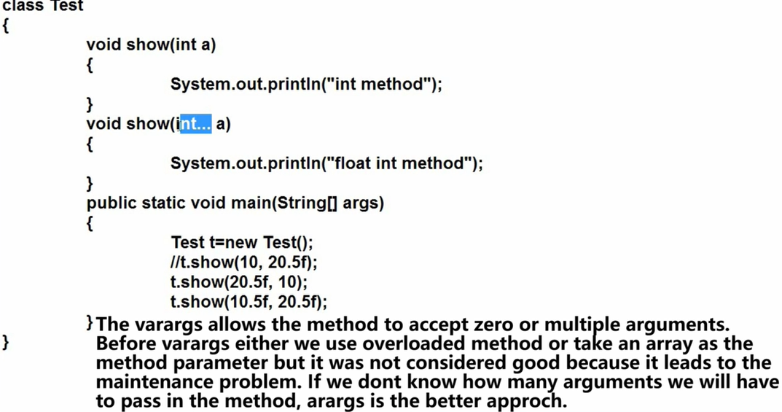

Slide 41
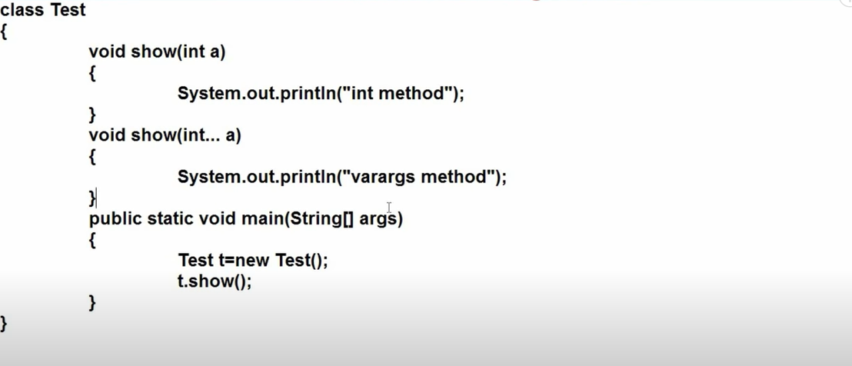

Slide 42
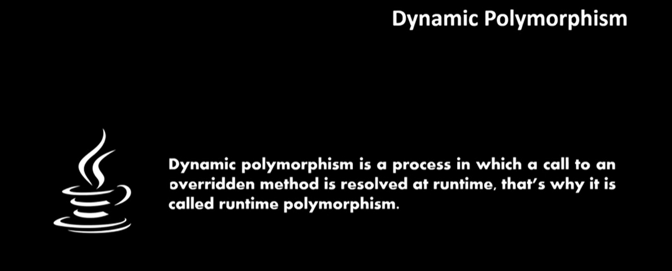

Slide 43
Class Shape
area( )
Circle object
area( circle)
triangle object
area(triangle)
rectangle object
area(rectangle)
Virtual function

Slide 44
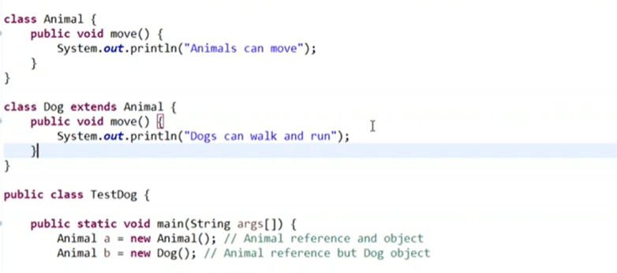

Slide 45
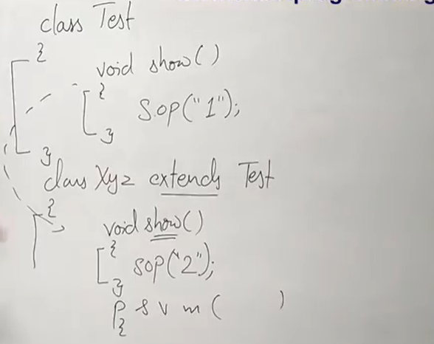

Slide 46
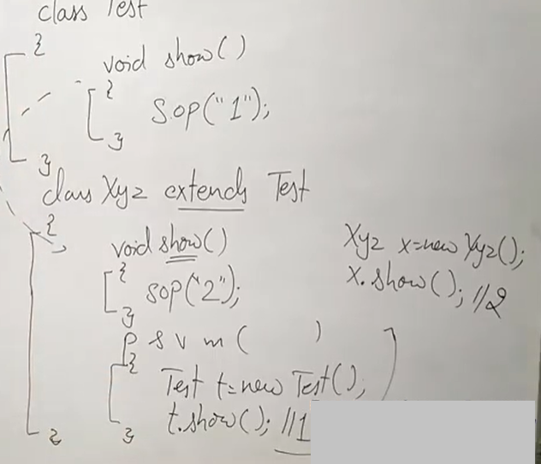

Slide 47
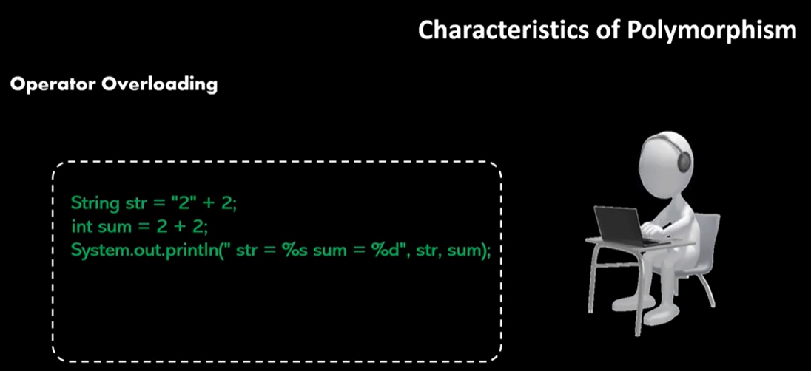

Slide 48
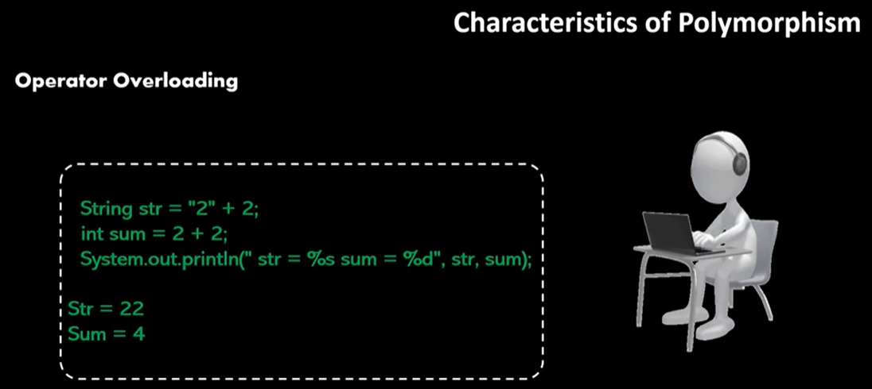

Slide 49
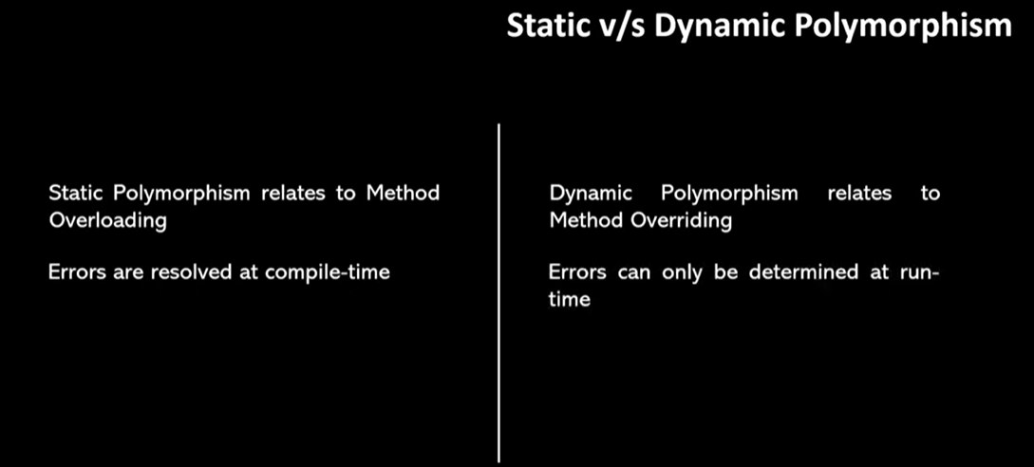

Slide 50
